Slide 1
Proposal for a phantom recipe for technical validation of photoacoustic imaging systems Working Groups 1 and 2
Presented by Joanna Brunker
on behalf of all working group members
Notes:
Good morning everyone, I’m Joanna Brunker and I’m presenting on behalf of the members of working group 1, as part IPASC, the International Photoacoustic Standardisation Consortium

Slide 2
Members of Working Groups 1 and 2
Joanna Brunker (Group lead)
Paolo Armanetti
Richard Bouchard
Lina Hacker
Jithin Jose
Thomas Kirchner
Efthymios Maneas
Luca Menichetti
UK
Italy
USA
UK
Netherlands
Germany
UK
Italy
James Joseph (Group co-lead)
Stefan Morscher
Srinath Rajagopal
Lisa Richards
William Vogt
Maximillian Waldner
Wenfeng Xia
Bajram Zeqiri
UK
Germany
UK
USA
USA
Germany
UK
UK
Notes:
I would like to start by acknowledging and thanking all members of this working group. These members are based all over the world, and their contributions through long distance video calls and emails, as well as their experimental efforts have all helped to drive this consortium forwards

Slide 3
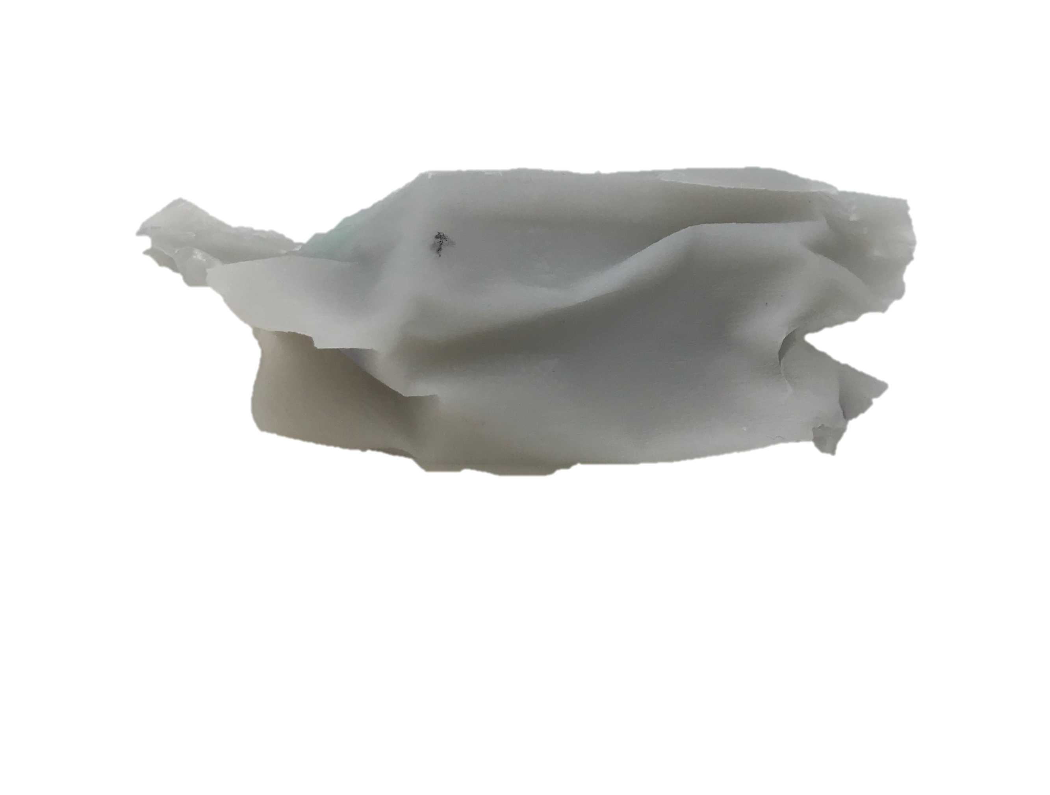
Mission of WG 1 and 2: Phantom fabrication and characterisation
To determine suitable materials
To define optical and acoustic properties
To fabricate and test PAI image quality phantoms with suitable configuration(s)
Notes:
The mission of these working groups can be summarised in terms of phantom fabrication and characterisation. And I’d like to emphasise that whilst the data I am presenting today is not significantly different from work in existing publications, the novelty lies in the international effort to draw together work from across the community in order to establish a set of protocols for standardising photoacoustic images acquired from various imaging systems. Our first goal was to determine

Slide 4
Phantom materials must fulfil certain requirements
Safe to (prepare and) handle without specialist facilities
Base components are widely available from commercial chemical vendors, with known intra- and inter-batch variation
Ease of purchase and/or fabrication
Ease of cleaning and/or maintenance
Long-term mechanical durability and temporal stability
Potential for re-calibration (checking properties against a gold standard)
Controllable (and biologically relevant) and optical parameters
Controllable (and biologically relevant) acoustic properties
Low propensity for photobleaching
Notes:
”grey” phantoms
QA/QC rather than biologically mimicking
Stability more important than biological properties for these studies

Slide 5
Two materials were identified as suitable phantom candidates
Material | Advantages | Disadvantages
Material | Advantages | Disadvantages
Polyvinyl chloride plastisol (PVCP) Bohndiek et al. 2013 Fonseca et al. 2015 Vogt et al. 2016 | Tissue-like acoustic properties Largely optically transparent Large Grüneisen parameter Solidity for suspending scatterers or absorbers Insoluble in water Tunable acoustic properties: hardener/softener Stable during storage, up to 3 months Can be used and re-used for imaging Tunable optical and acoustic properties
Material | Advantages | Disadvantages
Polyvinyl chloride plastisol (PVCP) Bohndiek et al. 2013 Fonseca et al. 2015 Vogt et al. 2016 | Tissue-like acoustic properties Largely optically transparent Large Grüneisen parameter Solidity for suspending scatterers or absorbers Insoluble in water Tunable acoustic properties: hardener/softener Stable during storage, up to 3 months Can be used and re-used for imaging Tunable optical and acoustic properties | Non trivial preparation 180°C needed for preparation might cause dye denaturation so only pigments should be used Higher acoustic attenuation than some soft tissues Lack of a widely available supply chain by reference chemical suppliers
Material | Advantages | Disadvantages
Polyvinyl chloride plastisol (PVCP) Bohndiek et al. 2013 Fonseca et al. 2015 Vogt et al. 2016 | Tissue-like acoustic properties Largely optically transparent Large Grüneisen parameter Solidity for suspending scatterers or absorbers Insoluble in water Tunable acoustic properties: hardener/softener Stable during storage, up to 3 months Can be used and re-used for imaging Tunable optical and acoustic properties | Non trivial preparation 180°C needed for preparation might cause dye denaturation so only pigments should be used Higher acoustic attenuation than some soft tissues Lack of a widely available supply chain by reference chemical suppliers
Gel wax Vieira et al. 2013 Cabrelli et al. 2015 Maneas et al, 2018 | Acoustic and elastic properties similar to tissue Tunable acoustic and optical properties Good temporal stability Ease of use Mechanical robustness
Material | Advantages | Disadvantages
Polyvinyl chloride plastisol (PVCP) Bohndiek et al. 2013 Fonseca et al. 2015 Vogt et al. 2016 | Tissue-like acoustic properties Largely optically transparent Large Grüneisen parameter Solidity for suspending scatterers or absorbers Insoluble in water Tunable acoustic properties: hardener/softener Stable during storage, up to 3 months Can be used and re-used for imaging Tunable optical and acoustic properties | Non trivial preparation 180°C needed for preparation might cause dye denaturation so only pigments should be used Higher acoustic attenuation than some soft tissues Lack of a widely available supply chain by reference chemical suppliers
Gel wax Vieira et al. 2013 Cabrelli et al. 2015 Maneas et al, 2018 | Acoustic and elastic properties similar to tissue Tunable acoustic and optical properties Good temporal stability Ease of use Mechanical robustness | Speed of sound lower than recommendation (1440-1445 ± 2.7 m/s vs. 1540 m/s) Not extensively validated in the literature so far Temperature dependency
Bohndiek, Sarah E., et al. 2013. PLoS ONE 8 (9): e75533. https://doi.org/10.1371/journal.pone.0075533. Maneas, Efthymios, et al. 2018. Biomedical Optics Express 9 (3): 1151.
Cabrelli, Luciana C., et al. 2015. Proceedings Volume 9531, Biophotonics South America: 95310L. Vieira, Sílvio L, et al. 2013. Ultrasound in Medicine & Biology 39 (12): 2477–84.
Fonseca, Martina, et al. 2015. Proc. SPIE: 953911 Vogt, William C., et al. 2016. Journal of Biomedical Optics 21 (10): 101405.
Notes:
Available of materials
More standardised materials – CAS numbers

Slide 6
Mission of WG 1 and 2: Phantom fabrication and characterisation
To determine suitable materials
To define optical and acoustic properties
To fabricate and test PAI image quality phantoms with suitable configuration(s)

Slide 7
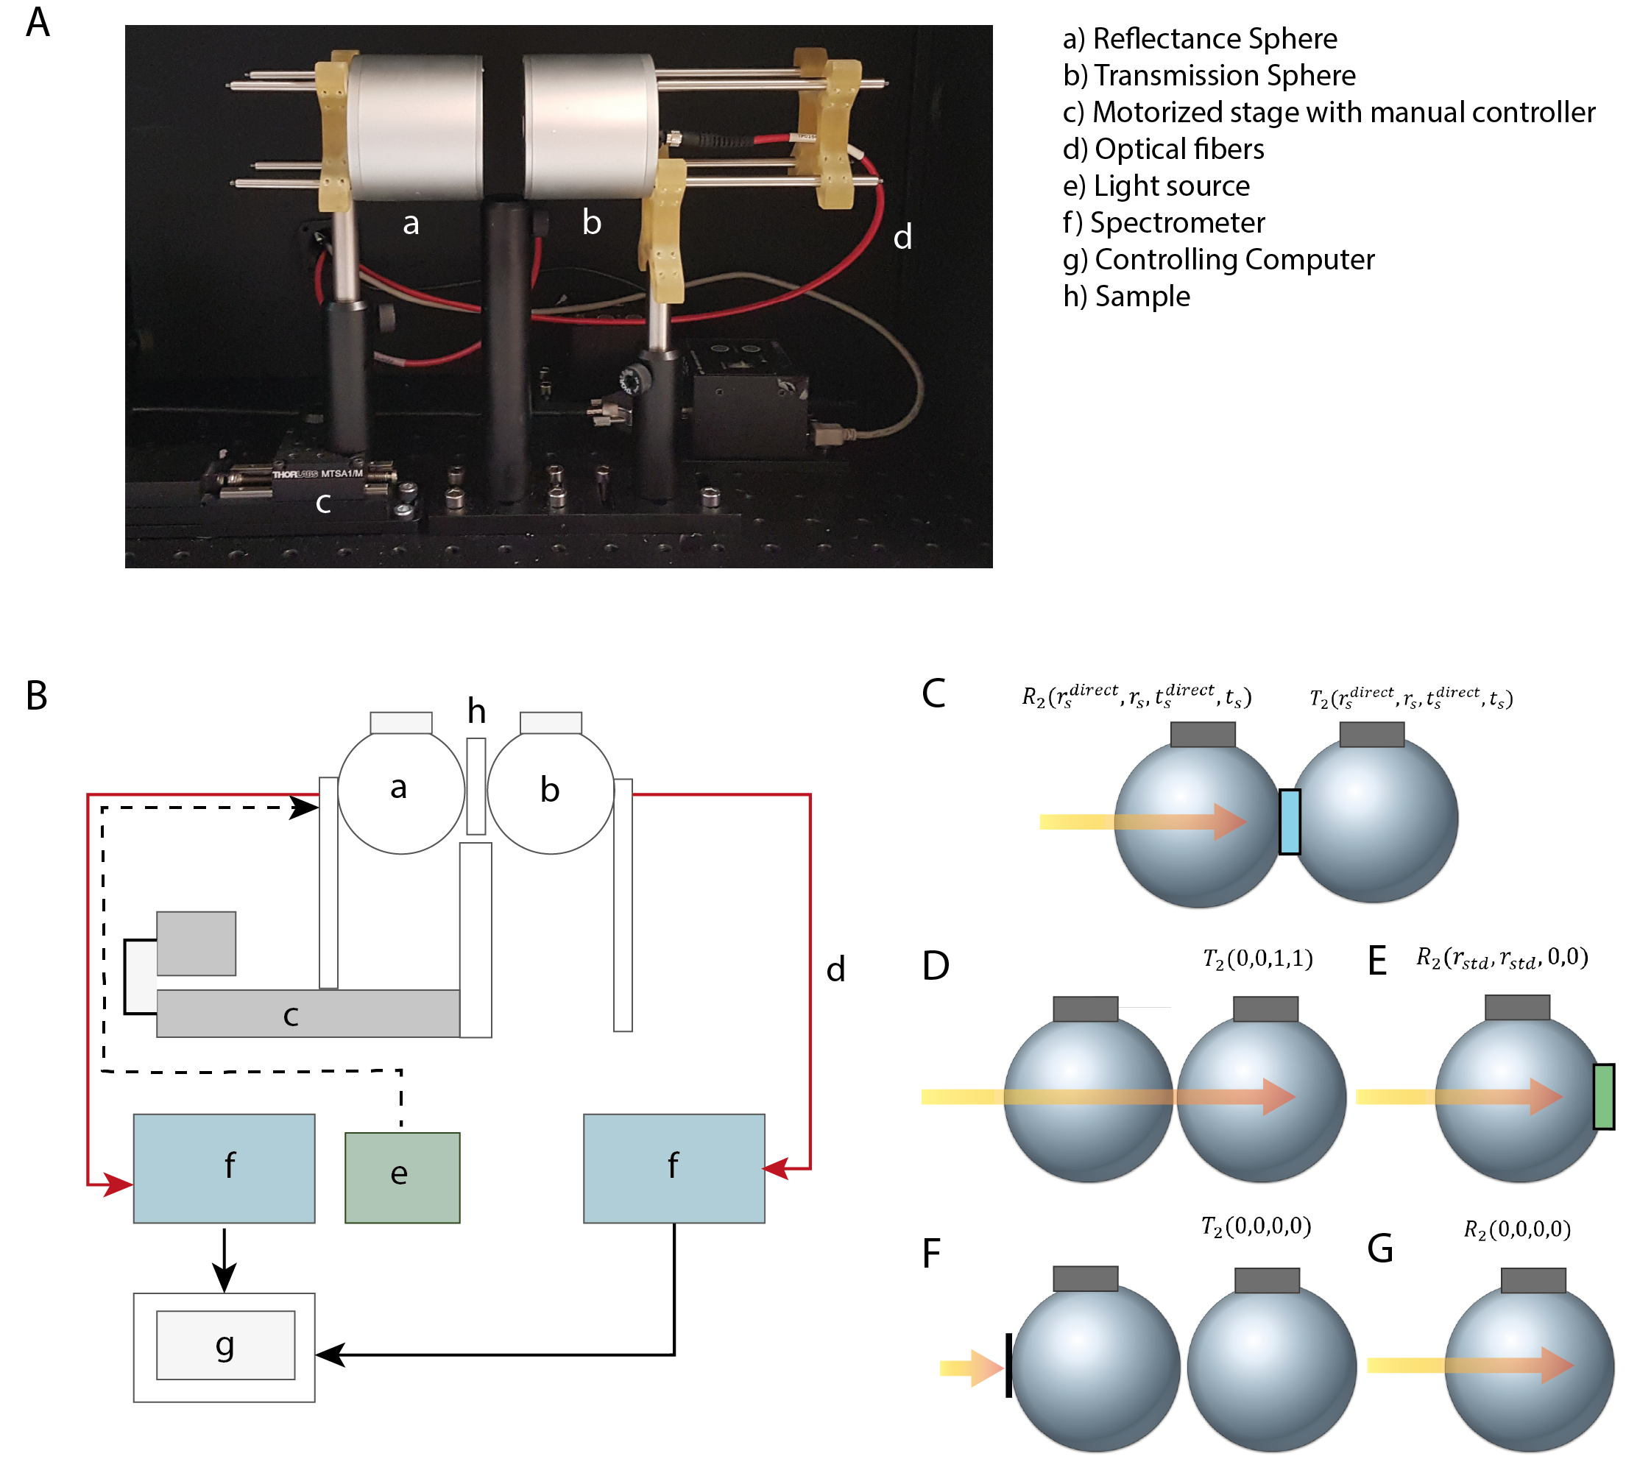
Double Integrating Sphere system for optical characterisation
Reflectance sphere;
Transmission sphere;
Motorised stage with manual controller;
Optical fibres;
Light source;
Spectrometer;
Computer;
Sample

Slide 8
Selection of target chromophores with known spectral features
Maneas, Efthymios et al (2018). Gel wax-based tissue-mimicking phantoms for multispectral photoacoustic imaging. Biomedical Optics Express, 9(3), 1151-1163.
Notes:
Will make different mixtures to better represent the haemoglobin spectra
DIS system (picture from Lina)

Slide 9
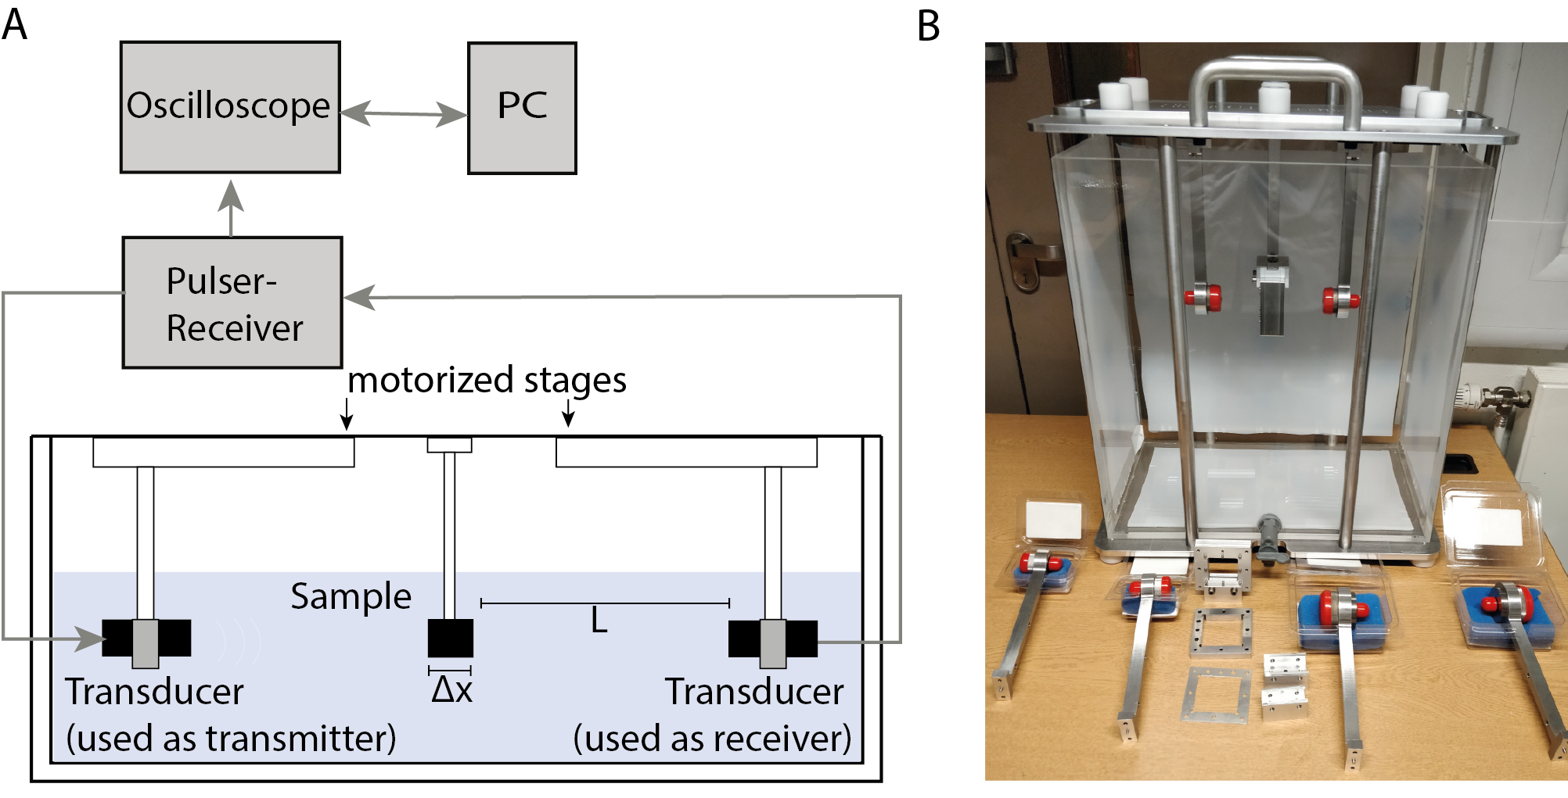
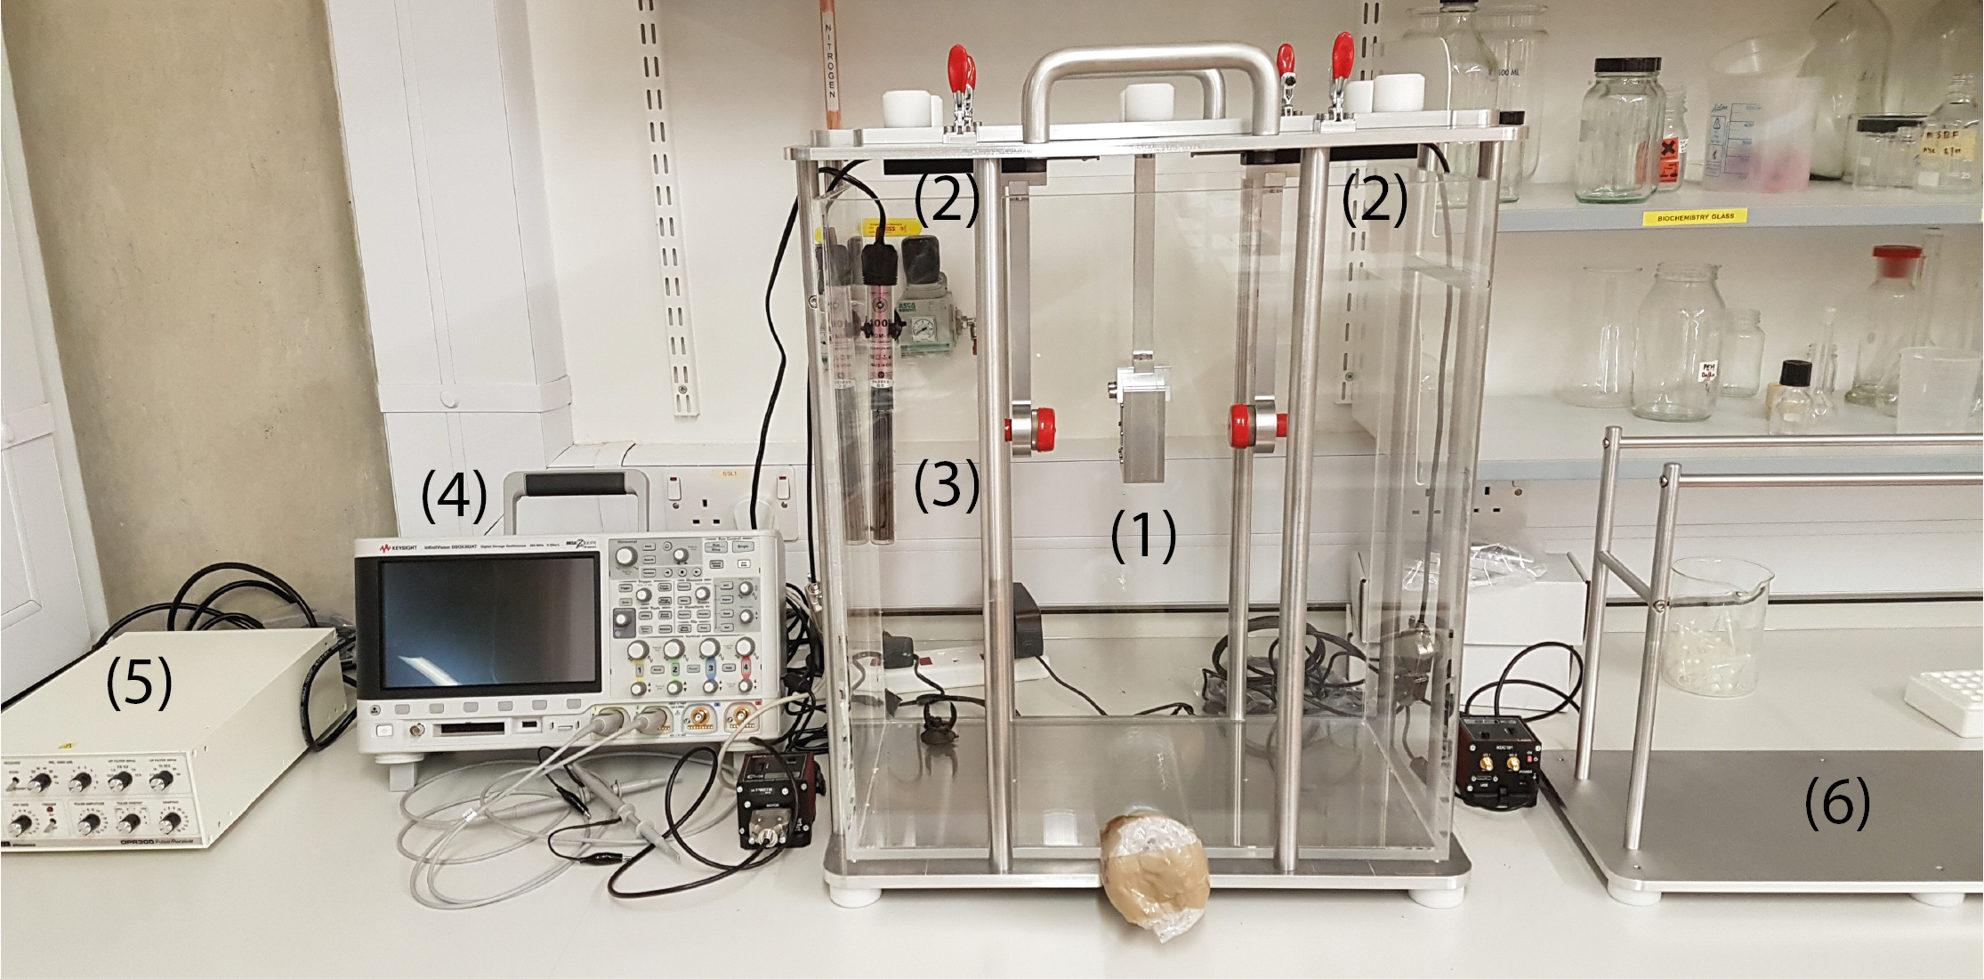
Acoustic properties characterized at Cambridge and NPL
(1) Sample holder; (2) Transducers; (3) Heater; (4) Oscilloscope

Slide 10
Target: Attenuation ≈ 1dB/cm; Velocity ≈ 1540 m/s
Thanks to Aoife Ivory, NPL

Slide 11
Mission of WG 1 and 2: Phantom fabrication and characterisation
To determine suitable materials
To define optical and acoustic properties
To fabricate and test PAI image quality phantoms with suitable configuration(s)

Slide 12
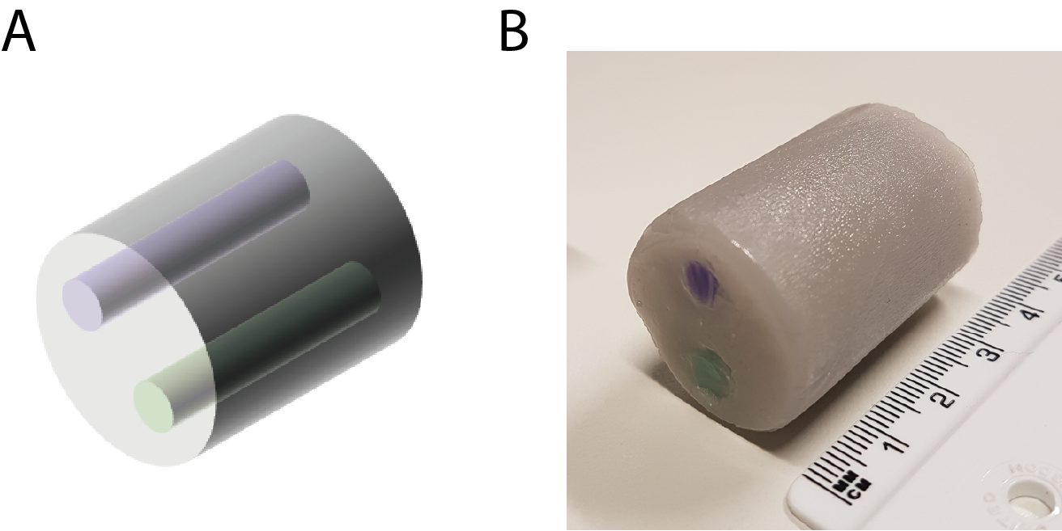
Phantoms were gel-wax cylinders with chromophore inclusions
Inclusion 1: gel wax mixed with Carbazole Violet (μ_{a} ≈ 0.1 cm⁻¹ at 800 nm)
Background: gel wax mixed with black ink
(μ_{a} ≈ 0.02 cm⁻¹ at 800 nm)
Configuration for
pre-clinical imaging
Inclusion 2: gel wax mixed with Pthalo Green (μ_{a} ≈ 0.3 cm⁻¹ at 800 nm)
28 mm
4 mm
Notes:
Shape optimised for cylindrical imaging
Diameter: 28 mm; inclusions: 4 mm

Slide 13
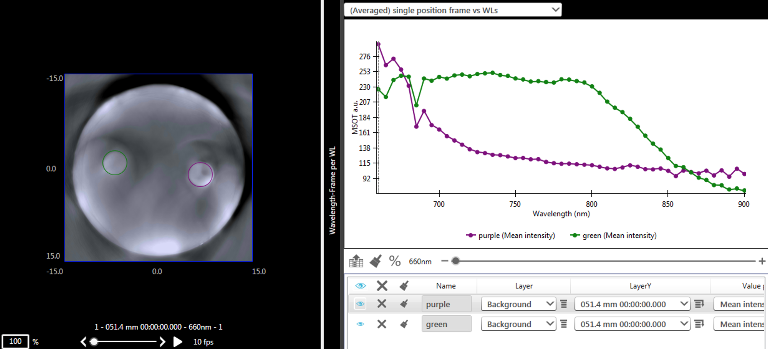
A protocol was designed for standardised phantom imaging

Slide 14
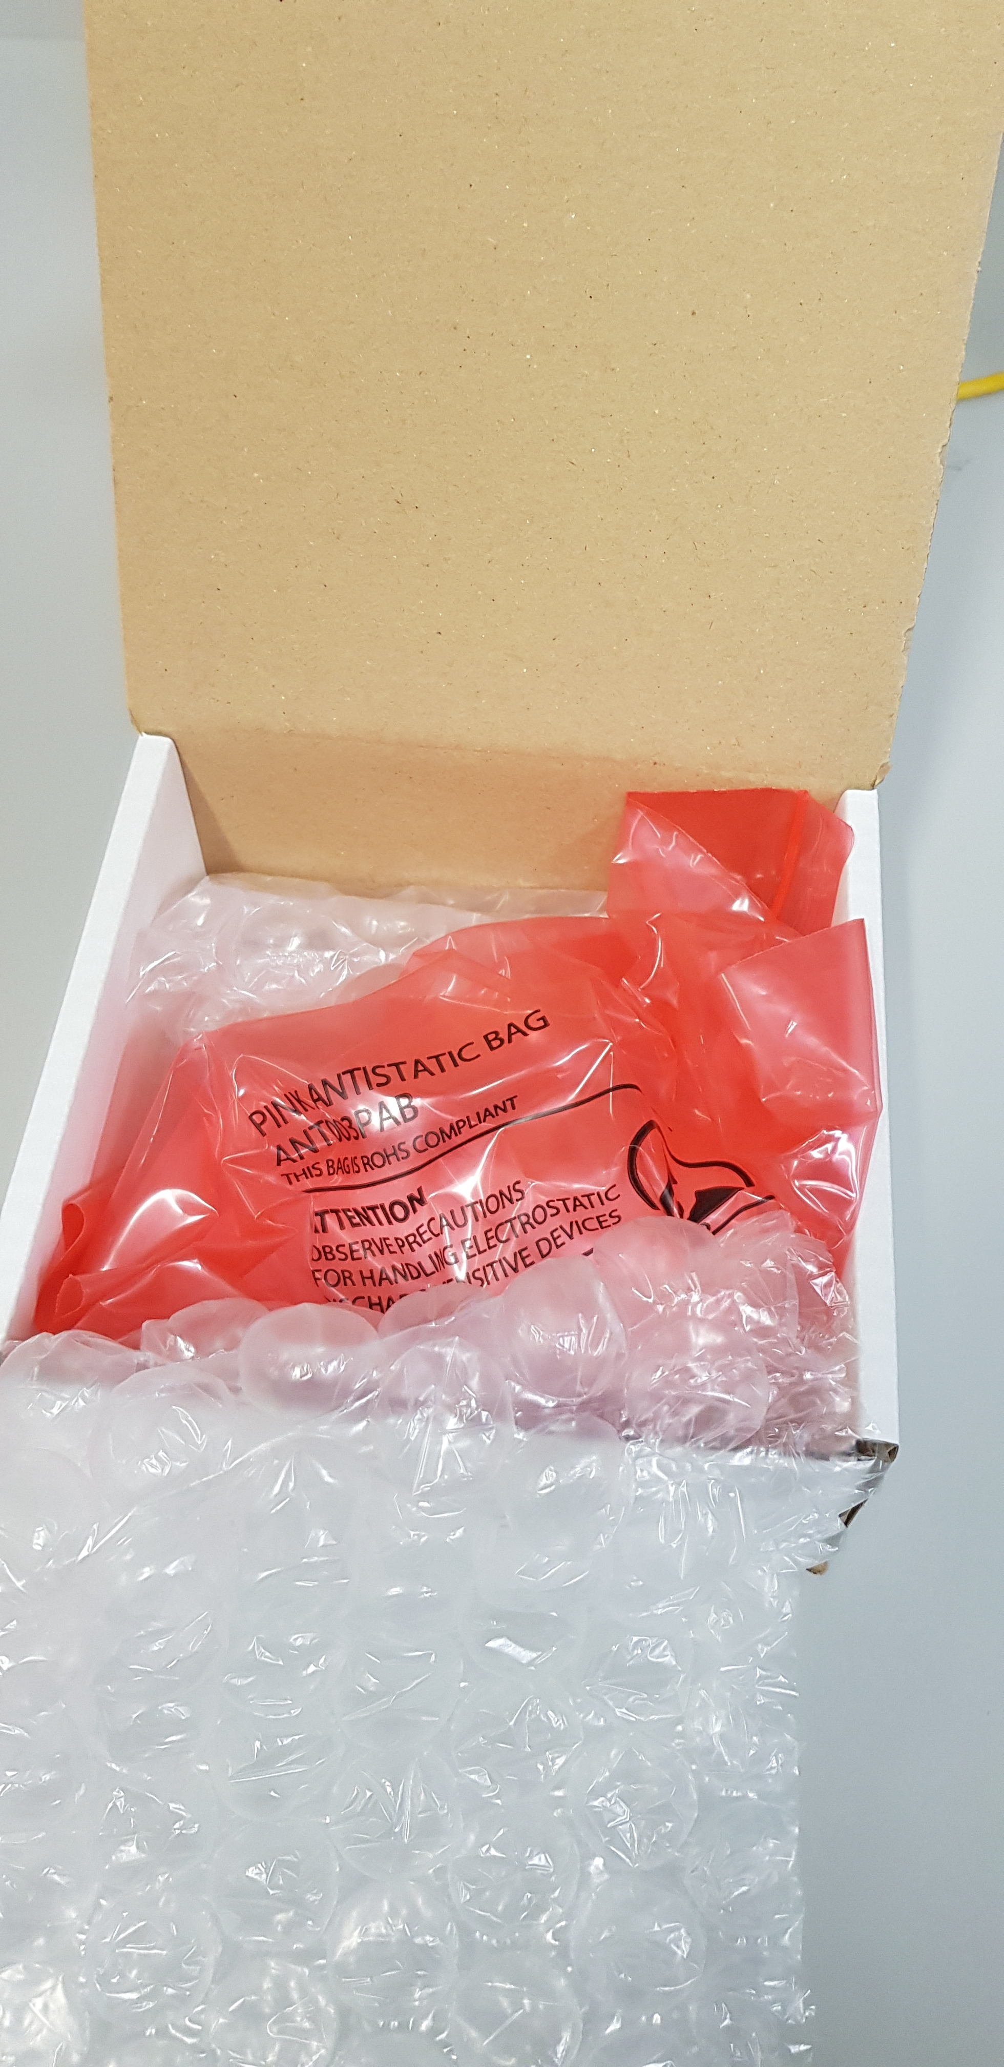
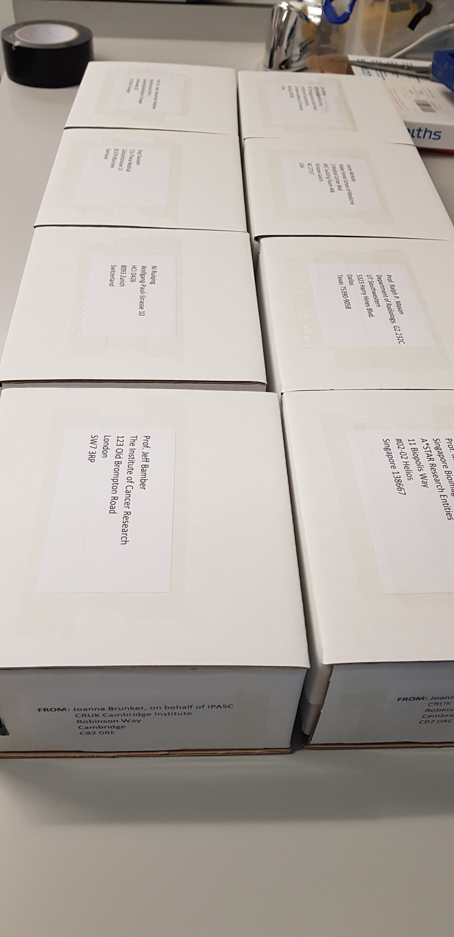
Phantoms were shipped to 8 sites
Jeff Bamber
Jing Claussen
Ralph Mason
Lacey McNally
Ruiqing Ni
Malini Olivo
Maximillian Waldner
Kun Wang
UK
Germany
USA
USA
Switzerland
Singapore
Germany
China

Slide 15
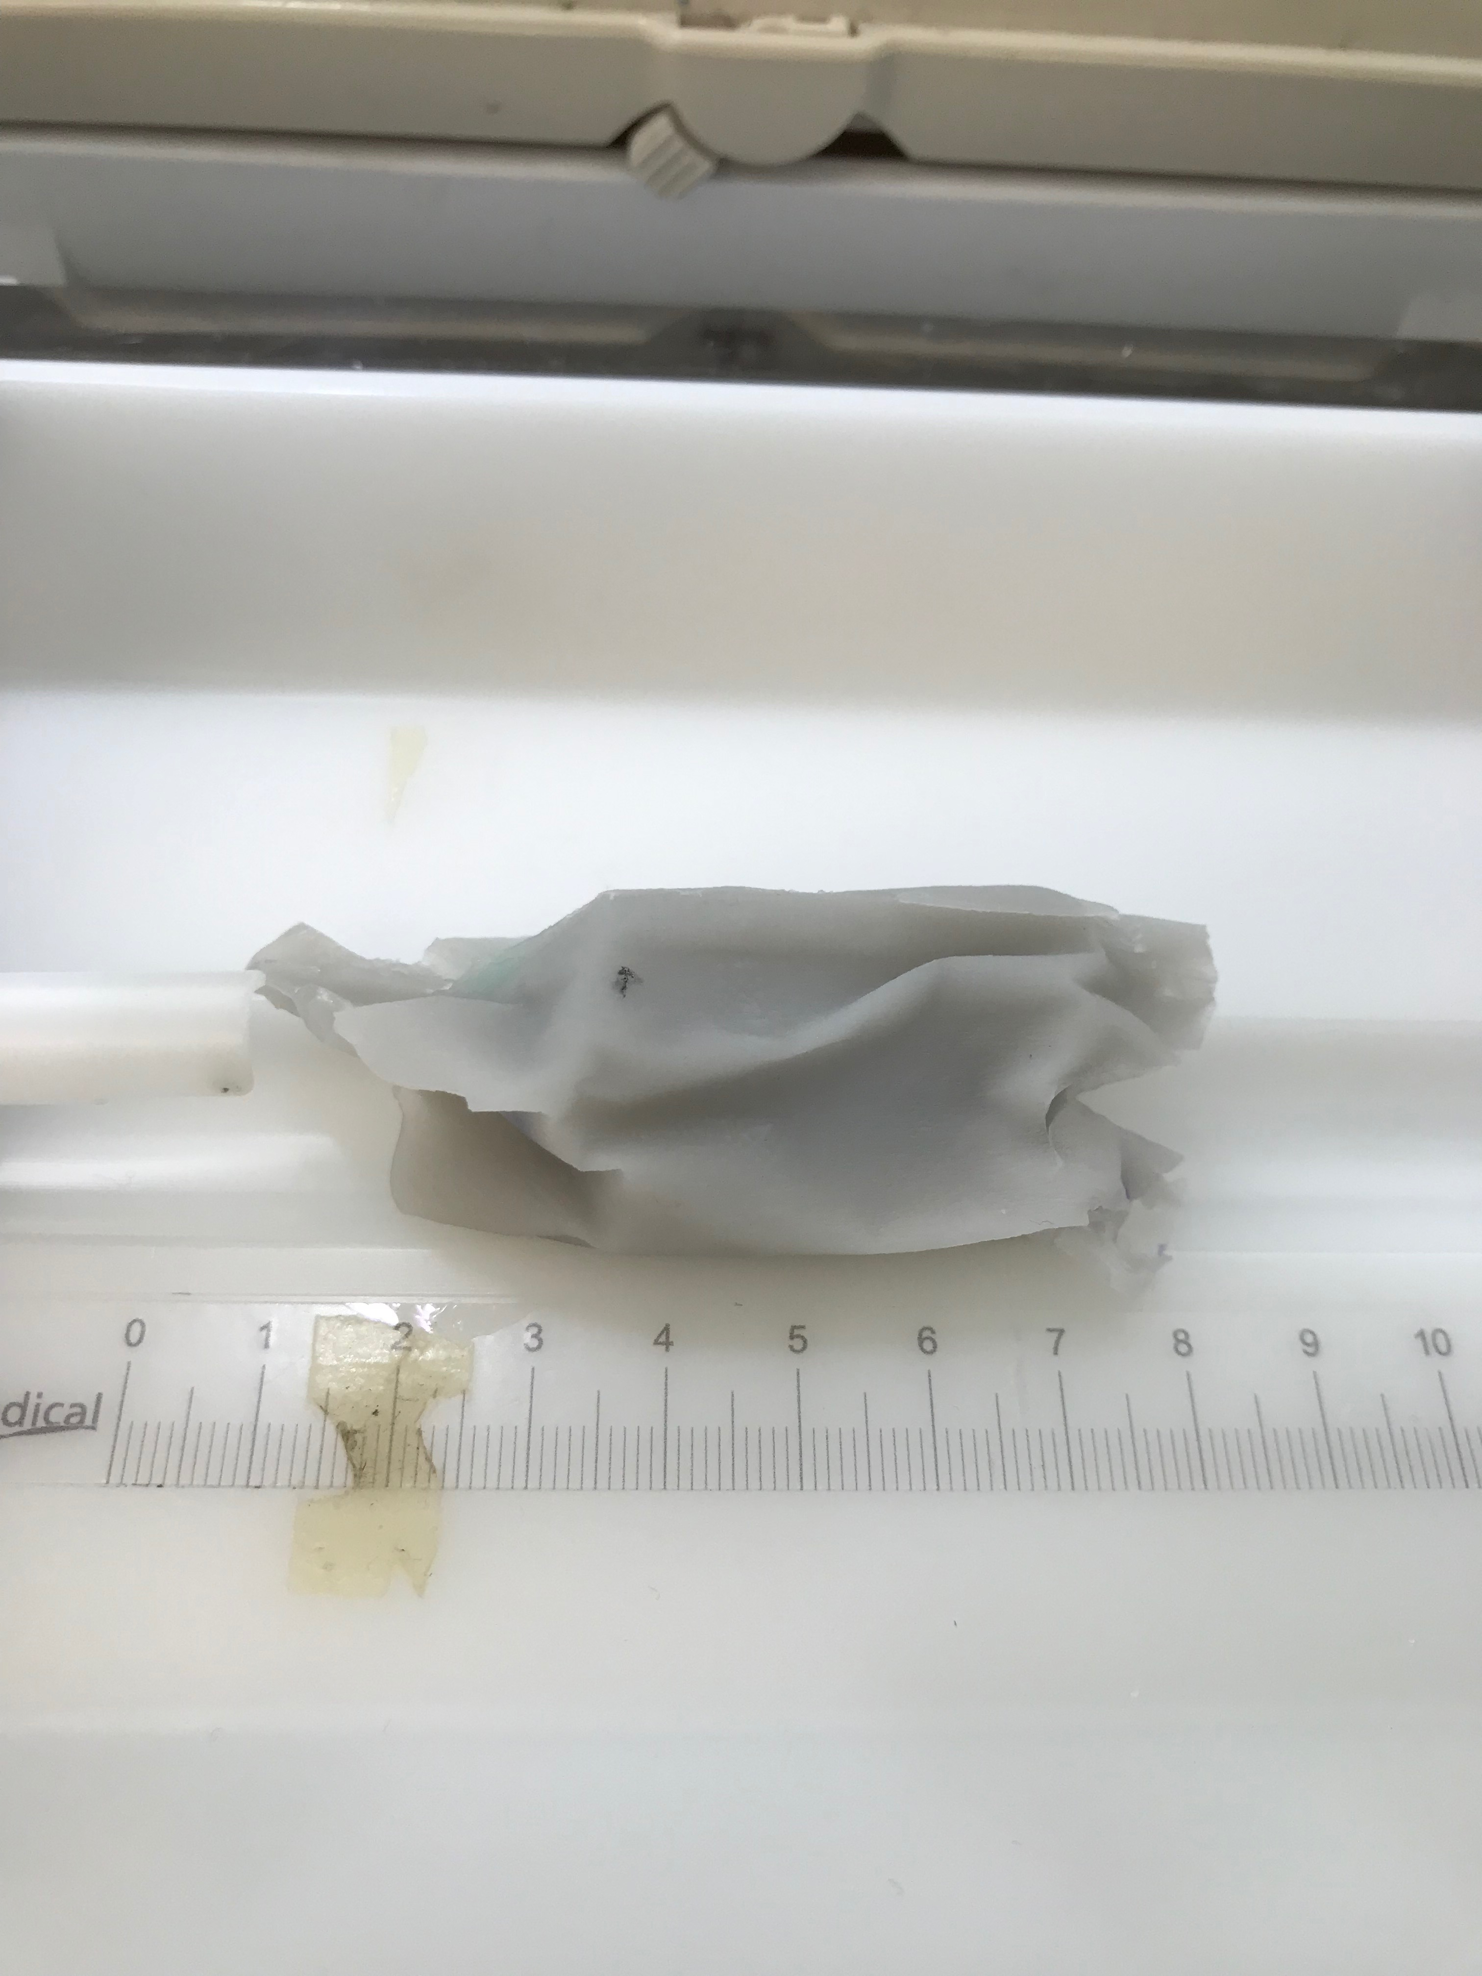
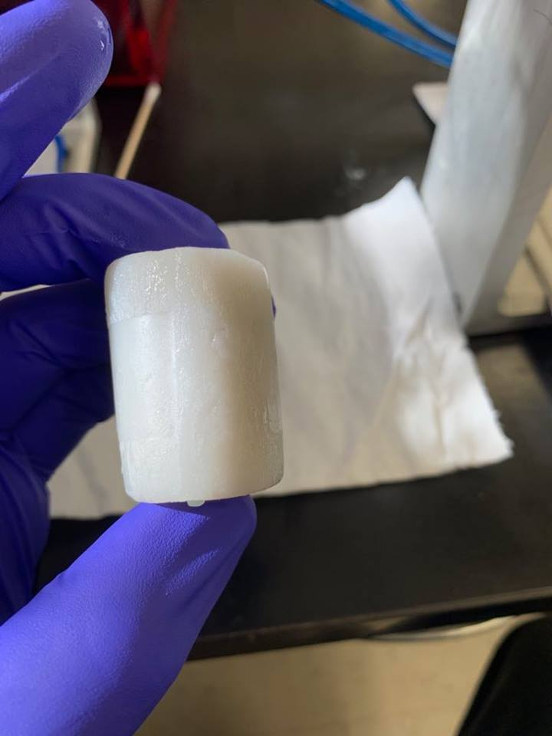
Phantoms suffered some mechanical and thermal damage

Slide 16
In general: Pilot study data received from 4 sites show good agreement with imaging data recorded before shipping
Ratio of purple to green intensities
COV in green SBR

Slide 17
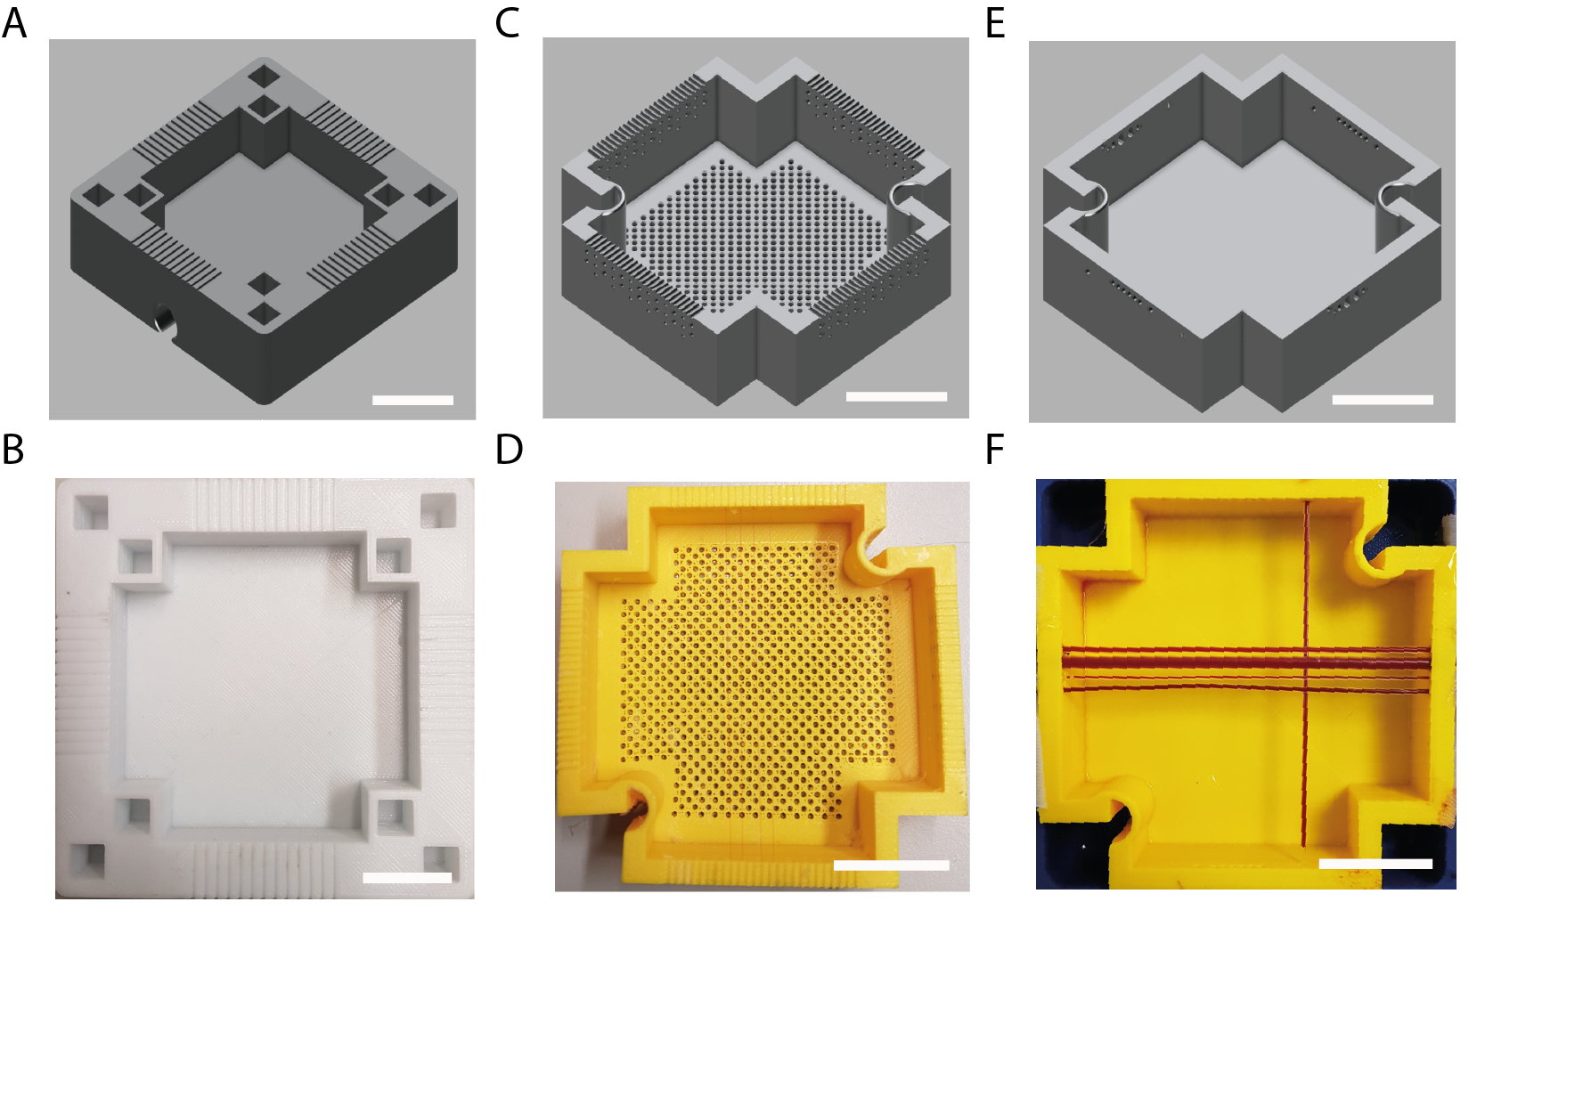
Next steps
Adapt recipe to improve mechanical and thermal stability, and speed of sound
New dye mixtures to create more distinct spectral features
Design phantom configurations suitable for a wide variety of PA imaging systems
Define comparison metrics e.g. resolution, SNR
Scale bar: 20 mm

Slide 18
Acknowledgements
Working Group Leads
Joanna Brunker UK
James Joseph UK
Lina Hacker UK
Janek Grohl Germany
William Vogt USA
Chair - Sarah Bohndiek UK Co-Chair - William Vogt USA
Academic Members
Paolo Armanetti Italy
Hisham Assi Canada
Jeff Bamber UK
Paul Beard UK
Thomas Berer Austria
Richard Bouchard USA
Kimberly Briggman USA
Lucia Cavigli Italy
Ben Cox UK
Adrien Desjardins UK
Jeeseong Hwang USA
Eno Hysi Canada
Aoife Ivory UK
Academic Members
Thomas Kirchner Germany
Jan Klohs Switzerland
Lena Maier-Hein Germany
Efthymios Maneas UK
Julia Mannheim Germany
Srirang Manohar Netherlands
Lacey McNally USA
Luca Menichetti Italy
Ruiqing Ni Switzerland
Malini Olivo Singapore
Marty Pagel USA
Geoff Parker UK
Anna Pelagotti Belgium
Academic Members
Antonio Pifferi Italy
Srinath Rajagopal UK
Daniel Razansky Germany
Avihai Ron Germany
Maximillian Waldner
Germany
Kun Wang China
Lihong Wang USA
Wenfeng Xia UK
Bajram Zeqiri UK
Industrial Members
Bryan Clingman USA
Drew Heinmiller Canada
Jithin Jose Netherlands
Steven Miller USA
Stefan Morscher Germany
Yoko Okamura Japan
Lisa Richards USA
Mithun Singh Japan
To find out more, please visit: www.ipasc.science

Slide 19
Mission of WG 1 and 2: Phantom fabrication and characterisation
To determine suitable materials
To define optical and acoustic properties
To fabricate and test PAI image quality phantoms with suitable configuration(s)
Notes:
The mission of these working groups can be summarised in terms of phantom fabrication and characterisation. And I’d like to emphasise that whilst the data I am presenting today is not significantly different from work in existing publications, the novelty lies in the international effort to draw together work from across the community in order to establish a set of protocols for standardising photoacoustic images acquired from various imaging systems. Our first goal was to determine

Slide 20
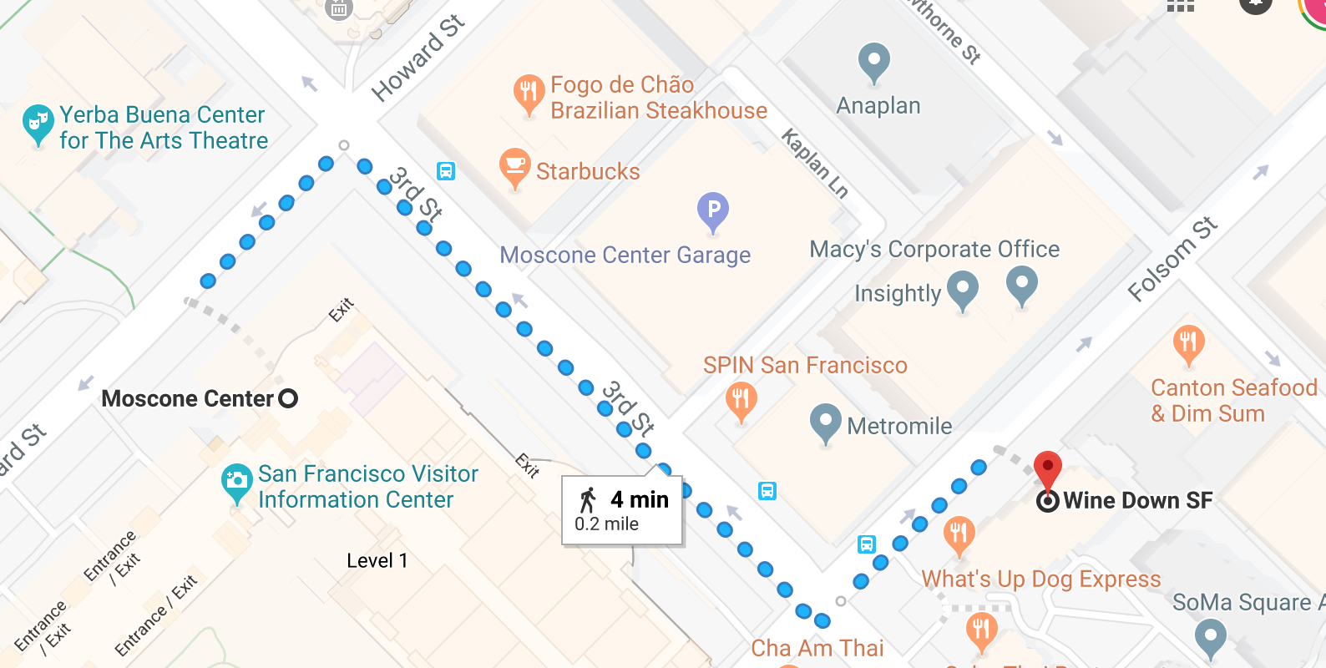
Join us for drinks, snacks and informal “phantom discussions”
Today (Tuesday 5th February)
5-8pm (drop in and out as you wish)
Informal discussions…
What are your experiences and ideas about imaging standardisation?
How would you make use of a standardisation phantom?
How can we use standardisation to facilitate clinical translation of PAI?

Slide 21
Technical characterisation of the RSOM system
Scale bar: 20 mm

Slide 22
Further considerations: need for standardized terminology
Quality assurance vs. quality control
Radiometry terms (radiant exposure, fluence, etc.)
Terms describing performance features of phantoms:
stability, durability,…
Measurement statistics terms:
reproducibility, repeatability,…
Image quality characteristics
what does ‘sensitivity’ mean?
for lateral resolution, what metric is used to define resolution measurement? FWHM size, 90% size, etc.
what SNR or CNR threshold defines a ‘barely detectable’ target?

